Slide 1
Capstone project, Mahindra first choice
Rushikesh,
Aditya

Slide 2
PS :1 Geological based customer analysis
Identifying the ownership pattern of cars throughout the country
This also captures the problem wherein information regarding the spending patterns can be identified

Slide 3
PS :2 Market Segmentation
Customer Lifetime value prediction
Based on CLV cluster the customer

Slide 4
PS :3 type of order each state receives
This could potentially give information about how Mahindra First Choice needs to be prepared to tackle various seasonal cases

Slide 5
Data Sets
Customer Data
(55533*10)
INVOICE
DATA
(984741 *59 )
MATERIAL
INVENTORY
DATA
(5619484*5)
PLANT
DATA
(483*14)

Slide 6
Customer data
Business Partner
Customer No.
Partner Type
Data Origin
Title
Marital Status
Occupation
Date Of Birth
Death Date

Slide 7
Invoice Data
Area / Locality
CITY
Customer No.
District
KMs Reading
Make
Model
Order Type
Parts Total
Pin code
Total Amt Wtd Tax.

Slide 8
Plant
Plant
Name 1
Valuation Area
Customer no. - plant
Vendor number plant
Factory calendar Name 2
House number and street
PO Box
Postal Code
City
Sales organization
State

Slide 9
MATERIAL INVENTORY DATA
DBM Order
Order Item
Material
Labor Value Number
Description
Item Category
Order Quantity
Target quantity UoM
Net value

Slide 10
EDA
Plant data
Invoice data

Slide 11
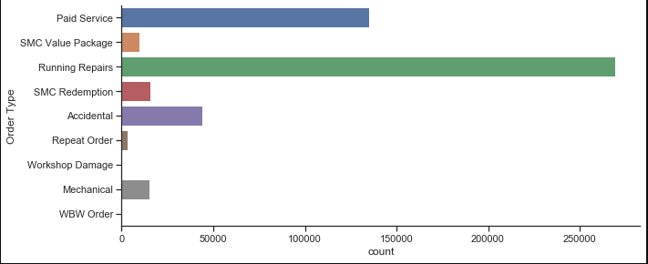
Order type frequency
We can see that running repairs have maximum orders and followed by paid services

Slide 12
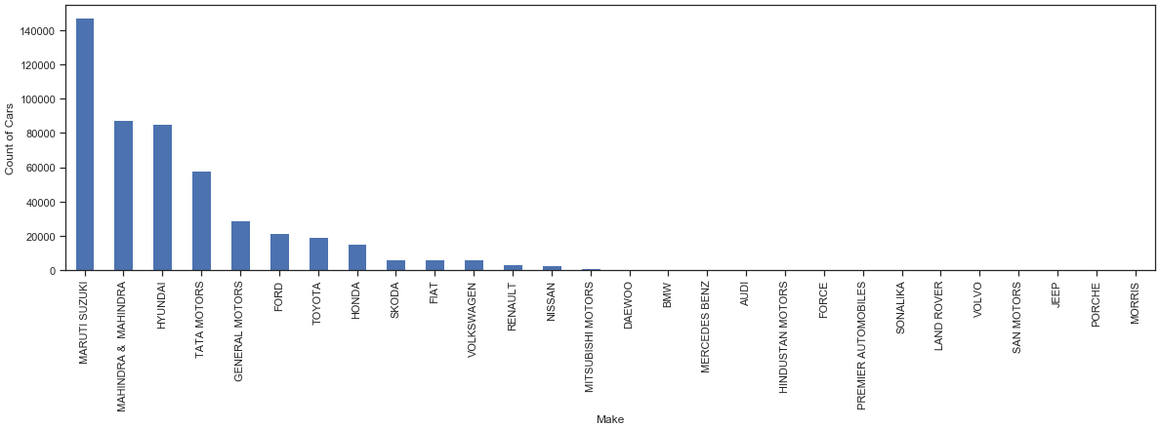
Maker’s count of cars
Maruti Suzuki has maximum car count followed by Mahindra & Mahindra , Hyundai. This can also be said Maruti dominates as it generates 26.45 % of entire revenue

Slide 13
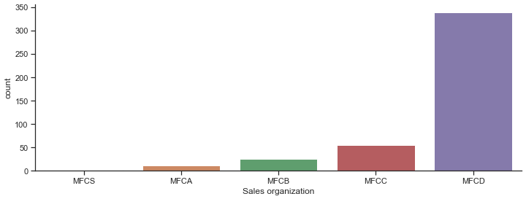
Plant’s Sales organization count
MFCD plant has performed well in generating new customers.
MFCC plant has relatively done average in generating new customers.

Slide 14
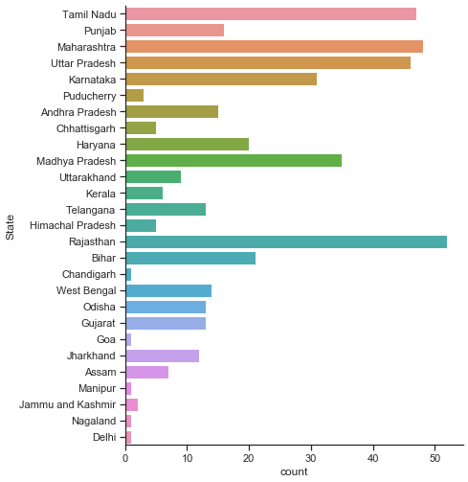
State-wise plant count
Maximum number of plants are located in
Rajasthan ,
Maharashtra,
Uttar Pradesh and
Tamil Nadu

Slide 15
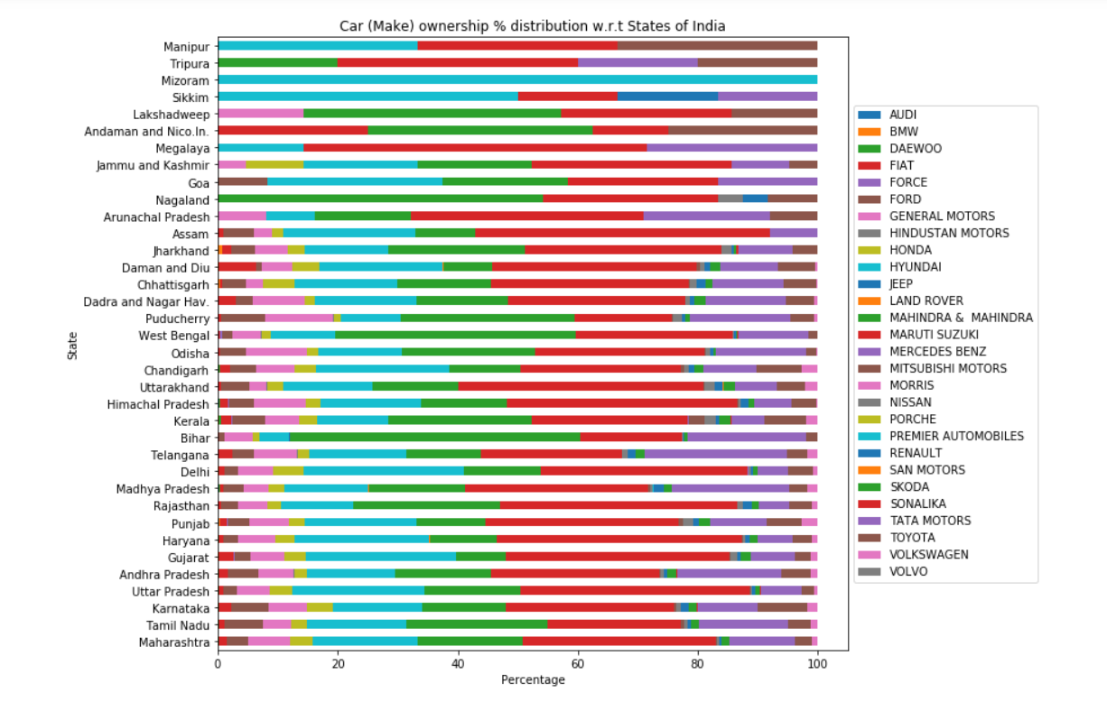
State-wise maker's percentage distributions
Makers like Maruti ,Skoda ,Tata, Mahindra & Mahindra has good proportion of percent through most states.
Meaning they have consistent sales in almost all states

Slide 16
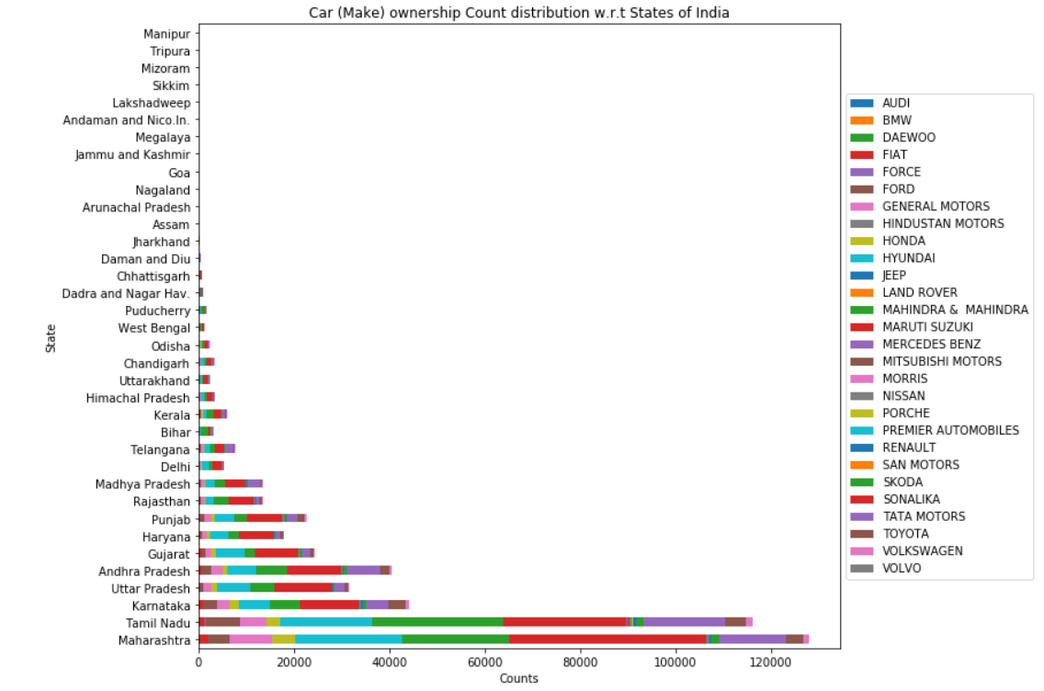
State-wise maker’s COUNT distributions
Maximum number of customer are located in
Maharashtra,
Tamil Nadu
Karnataka
Uttar Pradesh and
Andhra Pradesh

Slide 17
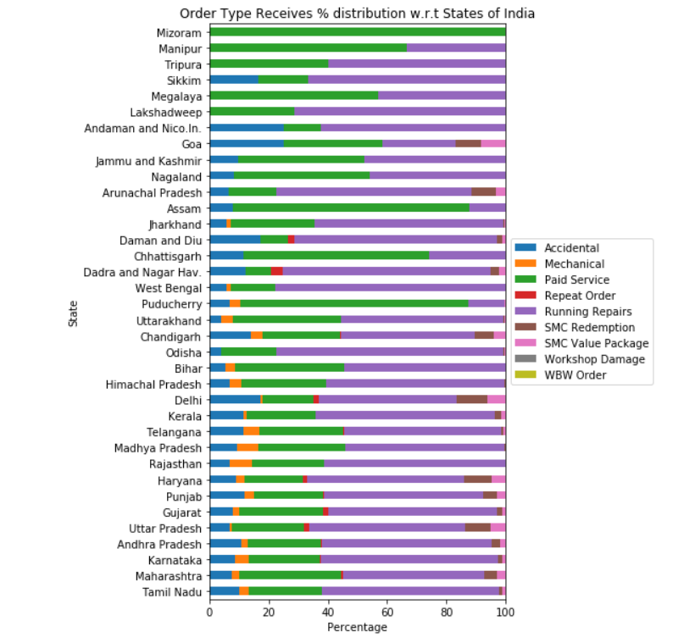
State-wise Order Type percentage distributions
Orders like Running Repairs ,Paid Services, Accidental has good proportion of percent through most states. But the proportion vary state to state.
Meaning we can expect such order types constantly and be ready for such type of order and optimizing requirements for such types of order will be beneficial and cost effective .

Slide 18
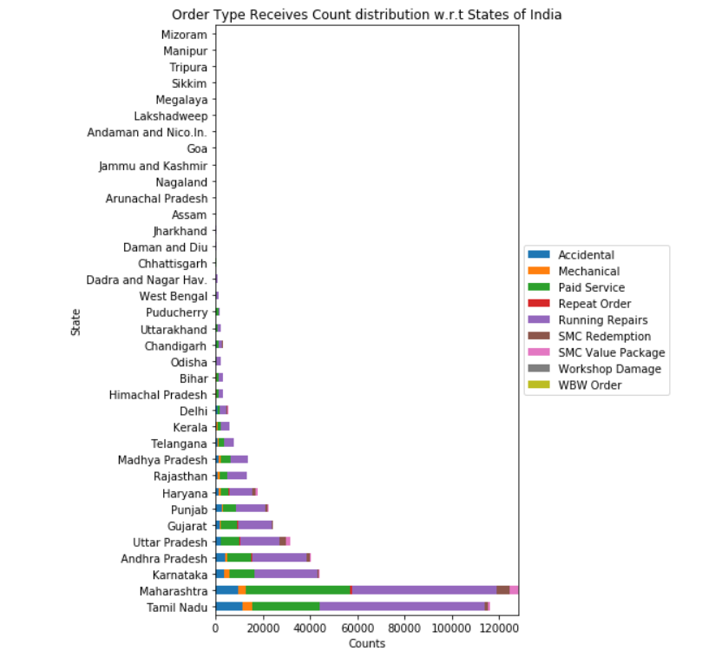
State-wise order types received count distributions
We can see that there is high correlation in state order counts and type of order received .
Meaning higher the order count more proportional the types of order gets, and cover all types of orders.
Like Maharashtra cover all types of order where as Jharkhand doesn’t

Slide 19
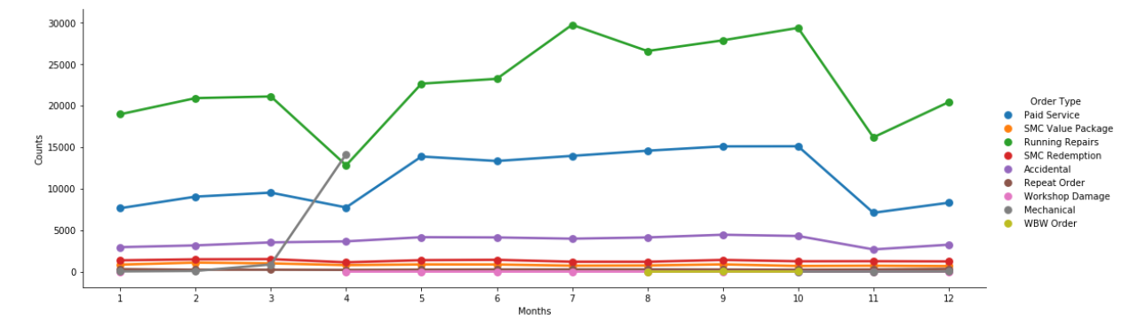
Month wise order type counts
Running repairs & Paid service dominates order type , but has striking pattern .
Whenever its rainy seasons or prior to rainy days customers order rates increases in order to safe guard vehicles & maintenance.

Slide 20
Feature engineering
Clean_Location_Area - Filtering Pin code and location based data from external source (pgeocode)
Service_Time_Hours - Converting (Invoice Date,Time) to (JobCard Date, Time) into hours
LTV (for Running Repairs) - Invoice No * Total Value
LTV Binned - Low, Medium, & High

Slide 21
Feature Selected for modeling
Make
Model
Clean_Location_Area
Customer No.
Invoice No.
Total Value
Service_Time_Hours
LTV (for Running Repairs)
LTV Binned

Slide 22
Model results with Random Forest Classifier
 | Precision | Recall | F1 | Support
0 | 0.92 | 0.81 | 0.86 | 6428
1 | 0.92 | 0.99 | 0.95 | 13144
2 | 0.8 | 0.77 | 0.78 | 6677
Accuracy |  |  | 0.89 | 26249
Macro avg | 0.88 | 0.86 | 0.87 | 26249
Weighted avg | 0.89 | 0.89 | 0.89 | 26249

Slide 23
Model results with XGb classifier
 | Precision | Recall | F1 | Support
0 | 0.98 | 0.77 | 0.86 | 6428
1 | 0.91 | 1 | 0.95 | 13144
2 | 0.78 | 0.81 | 0.80 | 6677
Accuracy |  |  | 0.89 | 26249
Macro avg | 0.89 | 0.86 | 0.87 | 26249
Weighted avg | 0.89 | 0.89 | 0.89 | 26249

Slide 24
Feature Selected for modeling wcss
Total revenue - Total revenue of customer
Total Servicing Hrs - average servicing time for q-cuts of 0.5, 0.25, 0.5, 0.75, 0.95
Customer Count - Total unique customer count
Cust Type - Customer type
Order type - type of order
Clean_city - clean city with external sources
Model - Type of car model arrived
Make - Name of manufacture

Slide 25
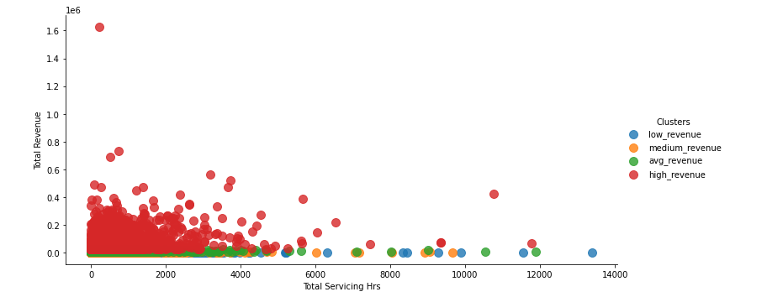
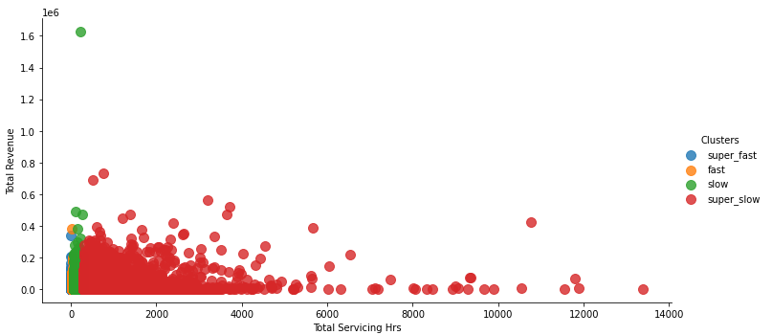
Model results with rule based clustering

Slide 26
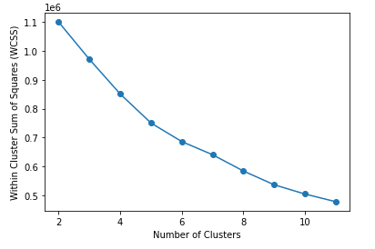
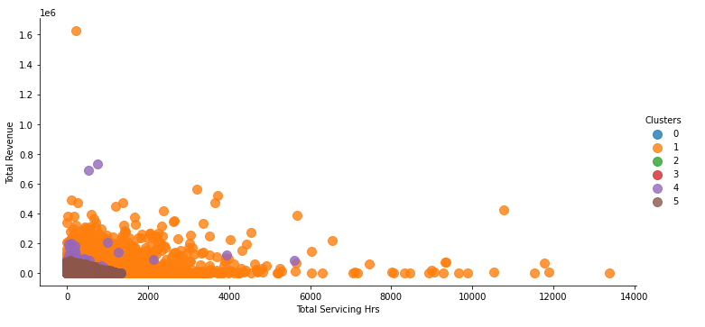
Model results with rule based clustering
Applied elbow method to determine optimum number of clusters

Slide 27
Conclusion
Data set was large but has many short comings , lack of consistency , invalid entries , and inaccurate entries .
South states has a lot better revenue generation and good order rate , which is inversely proportional to North counterpart states
Number of recurring order customer is very less with respect to regular customer. Many customer have single order .
Need to convert one timer order customers into multiple to regular customer , by providing discounts .
Encouraging existing customer to bring new customers by providing them offers, discounts .

